Slide 1
Chapter 3 figures

Slide 2
7.5 mm
3 mm
100 nm Ge
30 nm SiNx
500 μm Si
7.5 mm
3 mm
100 nm Ge
30 nm SiNx
500 μm Si
Notes:
Sample_Geometry.png

Slide 3
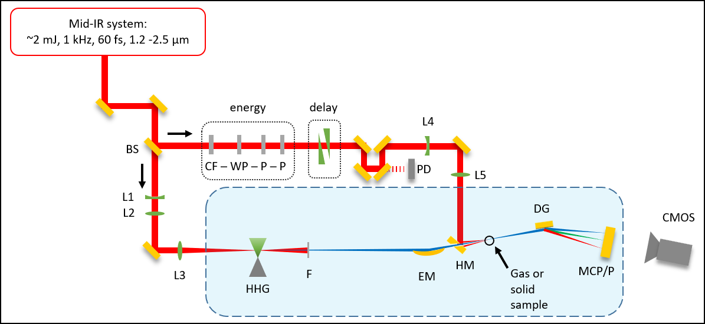
S
S

Slide 4
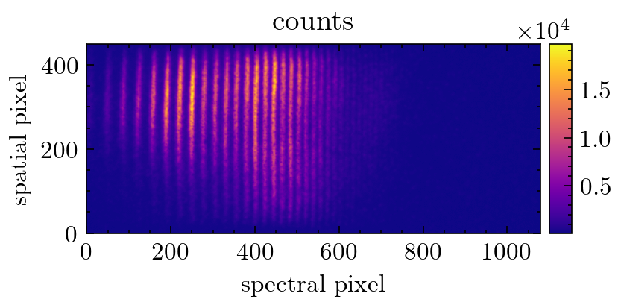
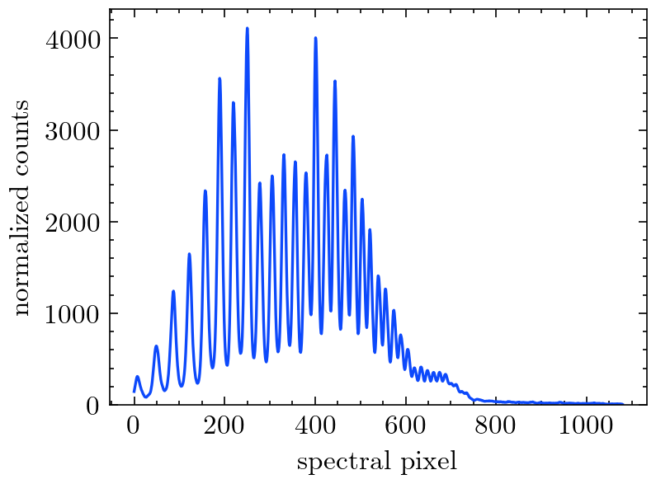
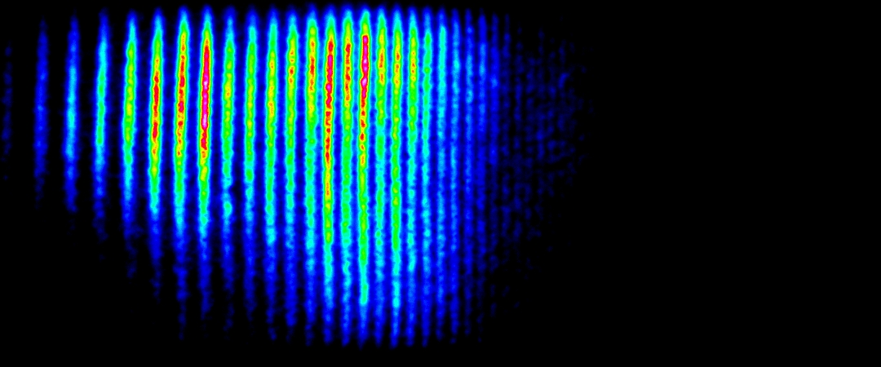
2D spectrometer image
Raw 2D image
Spectral lineout
Filtering
Delta-OD calculation
Delta-OD normalization
Average delta-OD
Energy calibration
Background subtraction, exposure time normalization, normalized spatial integration,

Slide 5
C
1 inch
FM
HM
SH
1 inch
L

Slide 6
Si, 260 nm
Si, one hole <200μm
“popped” 30 nm SiN

Slide 7
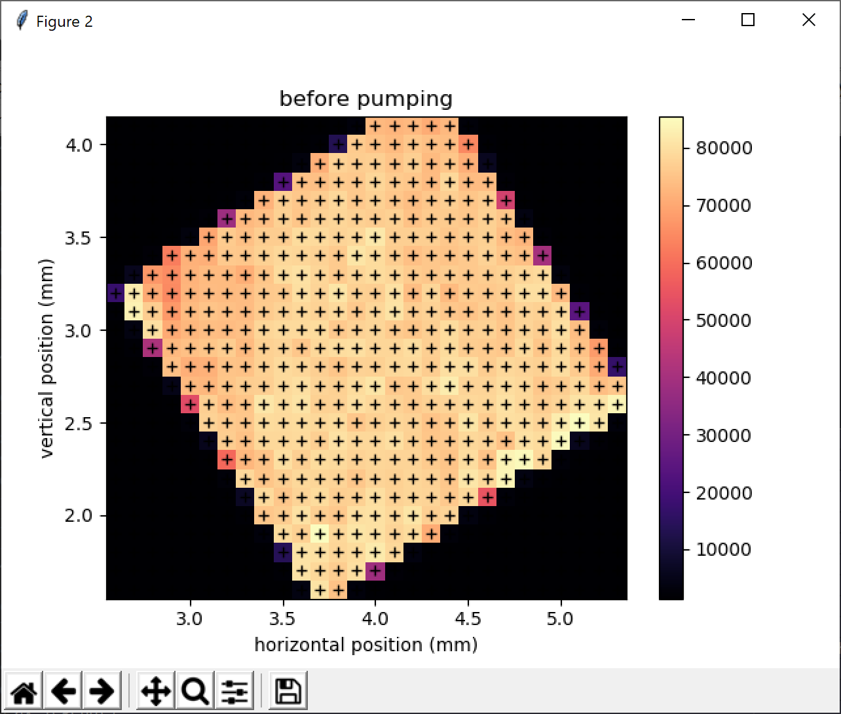
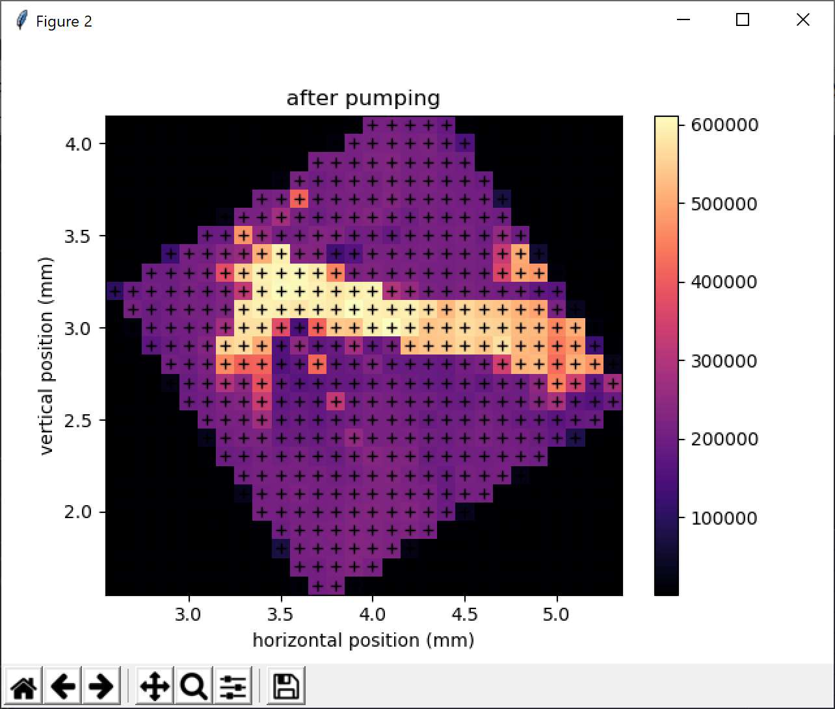
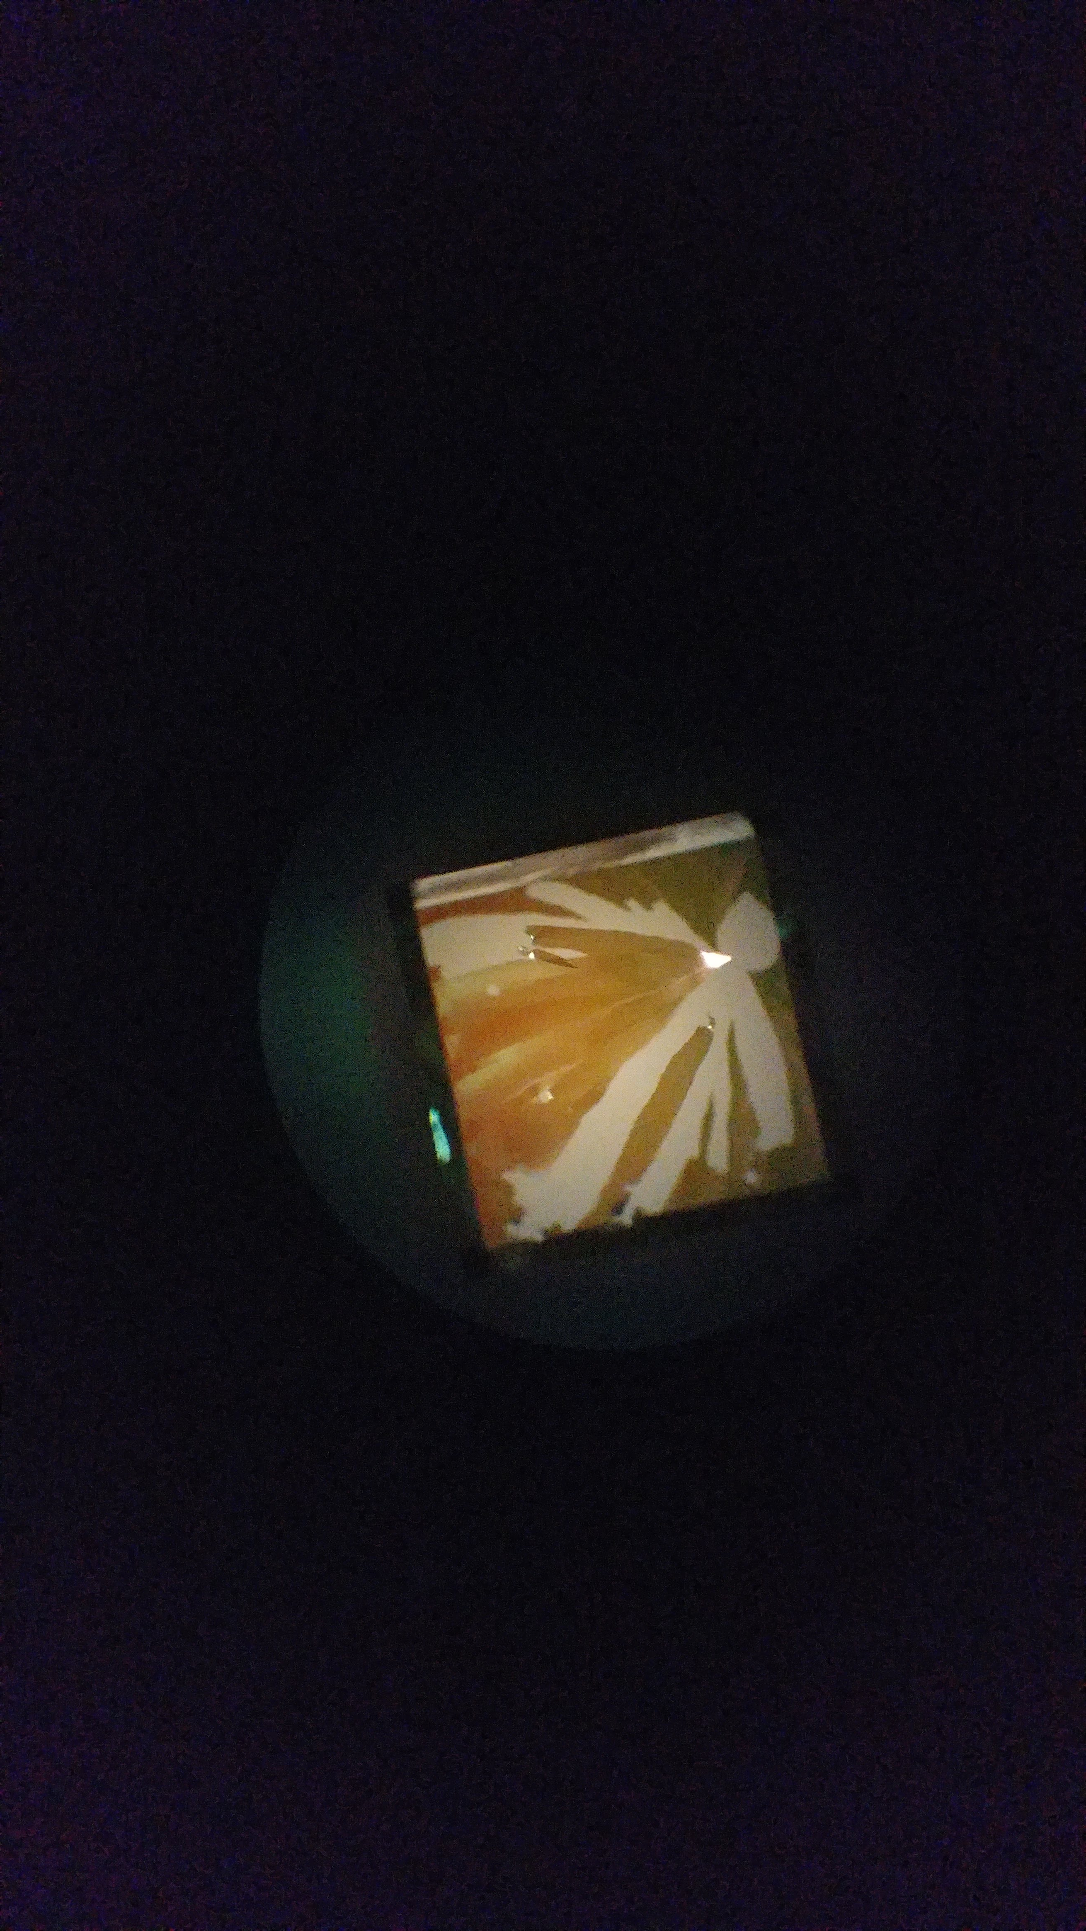
200 nm Si
200 nm Si
200 nm Si
IR-pumped areas
microscope image
Notes:
Figures from 2019-04-19 powerpoint presentation … not sure which data folder

Slide 8
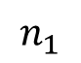
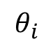
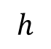
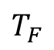
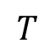
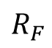
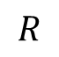
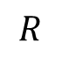
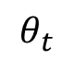
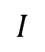
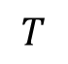
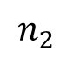
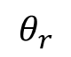
Fresnel geometry
a)
b)
$$h$$
$$I$$
interface
$$T$$
$$T_{F}$$
$$θ_{i}$$
normal
$$θ_{r}$$
$$θ_{t}$$
$$R$$
$$R$$
$$T$$
$$R_{F}$$
$$n_{1}$$
$$n_{2}$$

Slide 9
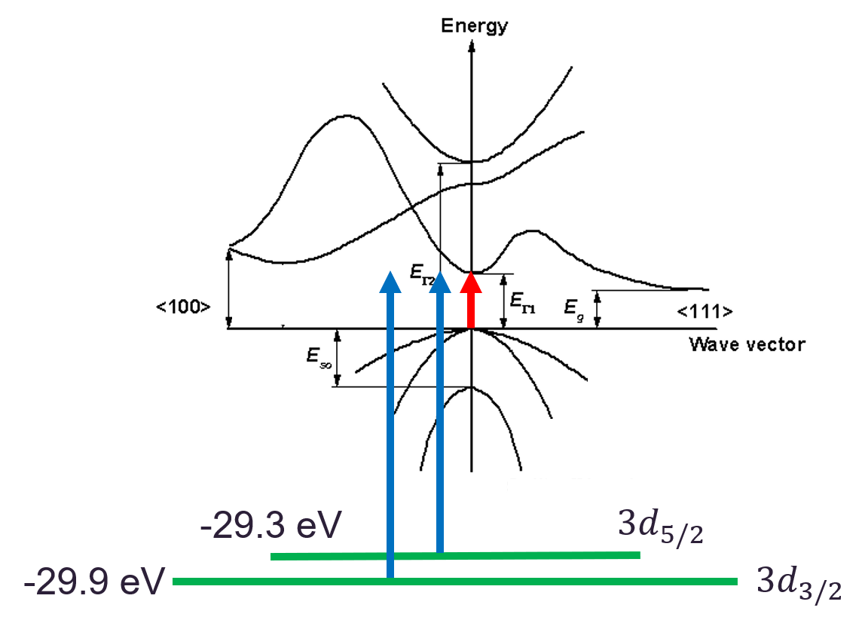

Slide 10

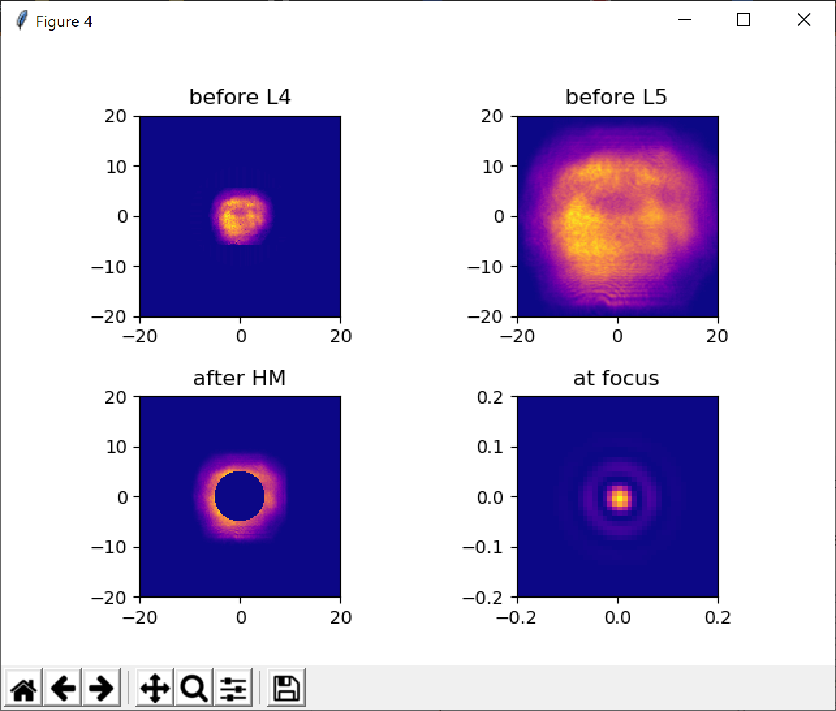
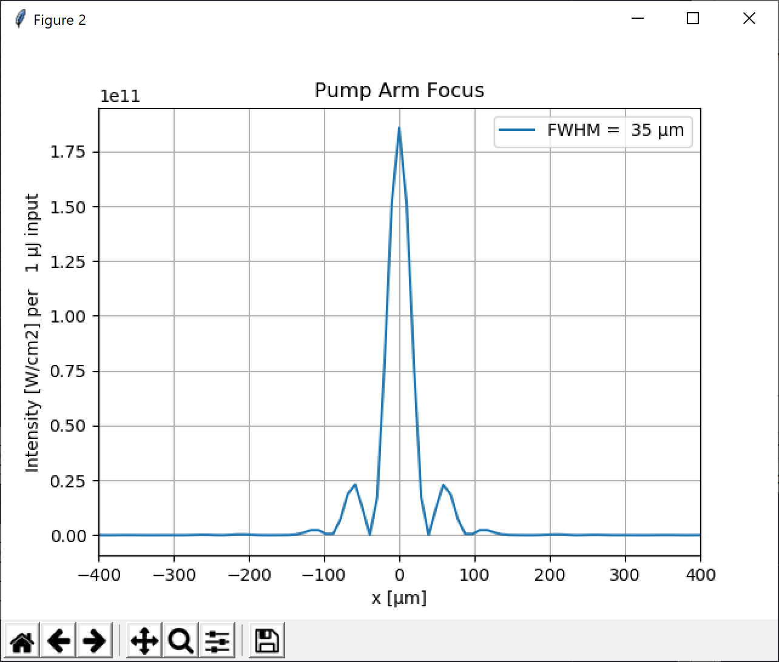
$$λ=1.5 μm$$
Notes:
20 mW = 20 mJ = 3.6 * 10^12 W/cm2
35 mJ = 6.3 * 10^12 W/cm2

